Slide 1
Traffic Flow Analysis Using Image Processing
Signal and Image Processing – 21AIE303
Batch – B Group -17

Slide 2


01
02
Team Members
03
04
Parthvi Manoj
CB.EN.U4AIE21143
Sakthi Swaroopan S
CB.EN.U4AIE21159
Sanjay Chidambaram
CB.EN.U4AIE21160
Taruneshwaran T
CB.EN.U4AIE21170

Slide 3

Problem Statement
Traffic Signal Optimization using Image and Video Analysis
Traffic congestion is a pervasive issue in urban areas, leading to increased travel time, fuel consumption, and environmental pollution. Traditional traffic signal systems lack adaptability and struggle to efficiently handle varying traffic conditions.
The problem is to design a system that optimizes traffic signal timings based on real-time traffic data, enhancing traffic flow and reducing congestion. In this context, leveraging advanced image analysis techniques becomes crucial for developing a smart and responsive traffic signal control mechanism.

Slide 4
Video Analysis
An Example of Traffic Analysis on a specific Lane in a Busy Road

Slide 5
Workflow for Video Analysis
Video Input
Masking
Binary Conversion
Prewitt Edge Detection
Frame by Frame
Converting to Grayscale
Morphological Operations (Opening)
Blob Analysis

Slide 6
Video Input & Frame Extraction
Video Feed Scenario
Frame Extraction
Traffic Signal
The Video feed will from existing traffic cameras in the city
At a fixed interval a frame is retrieved to be processed
Based on the result from processing the Signal is update

Slide 7
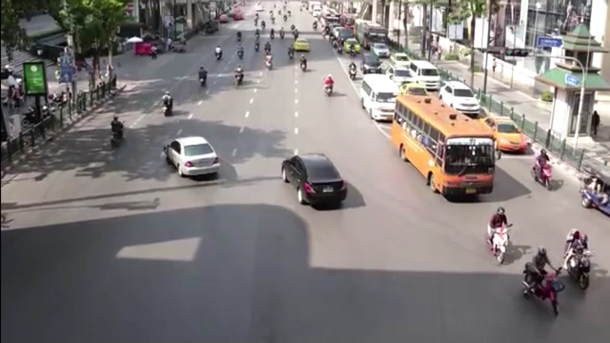

Masking
Example Frame
Mask to be Applied

Slide 8
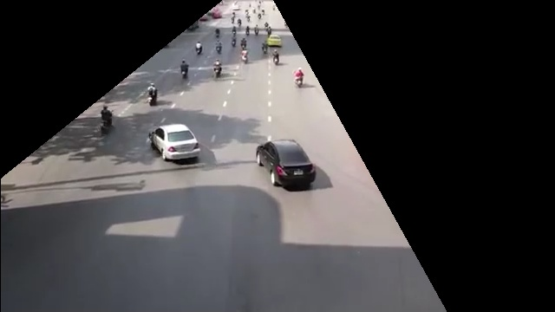
Masking
We need to Mask the Frame to specifiy our region of interest in the frame taken for analysis
This wont change as the Traffic Camera would be in a fixed location
Masked Image

Slide 9
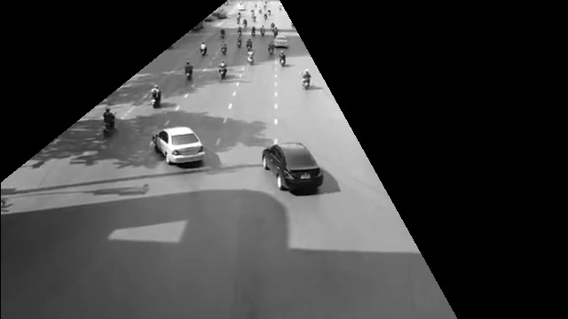
Converting to Grayscale
Need to convert to grayscale to then convert to a Binary (Pure Black & White Image) to use in edge detection
Grayscale Image

Slide 10
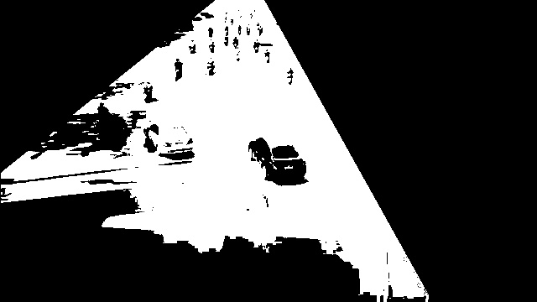
Binary Conversion
Pure Black and White Image

Slide 11
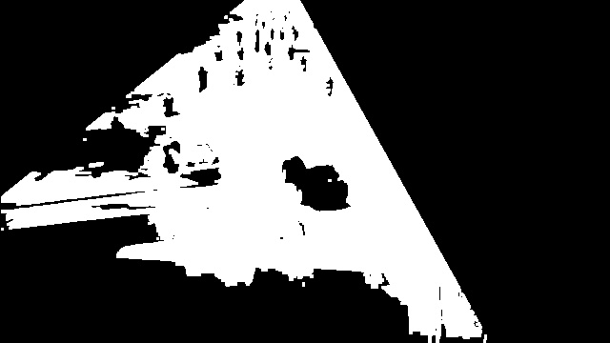
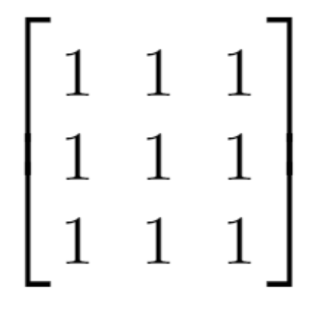
Morphological Operation (Opening)
Structuring Element
Performing Erosion then Dilution to eliminate any floating blobs

Slide 12
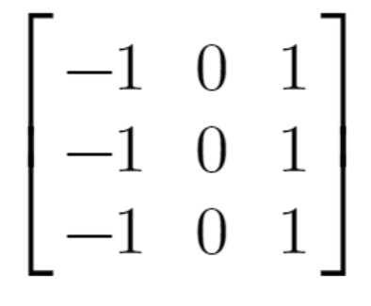
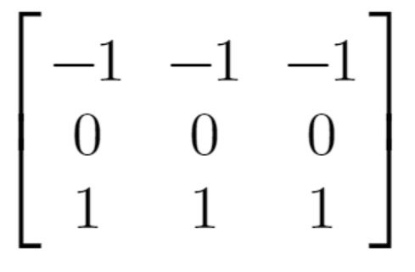
Prewitt Edge Detection
Structuring Element for
X Axis
Structuring Element for
Y Axis
Need to do X axis and Y axis seperately

Slide 13
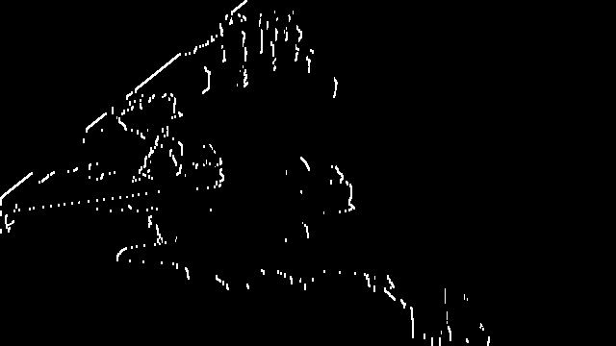
Prewitt Edge Detection
Edges Detected along X-axis

Slide 14
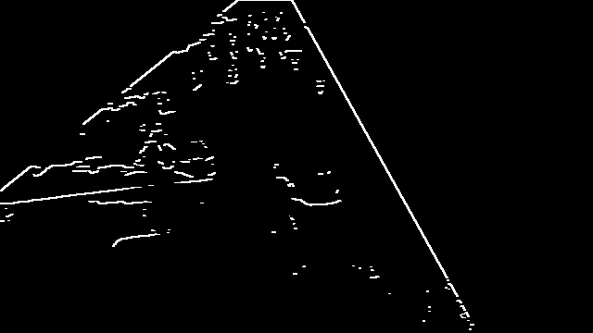
Prewitt Edge Detection
Edges Detected along Y-axis

Slide 15
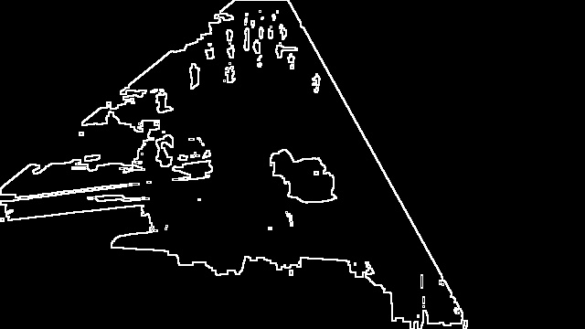
Prewitt Edge Detection
Combining both X axis and Y axis Edges into single image
We are squaring to remove any negative values that may be there in the image
prewitt = np.sqrt(prewitt_x**2 + prewitt_y**2)

Slide 16
Blob Analysis
Bob Analysis is a way of detecting big groups of connected pixels, usually used in conjunction with binary-like images, with clear contrast between regions in the picture
As there are multiple ways to analyse the image that we have processed so far like Canny Edge Detection (Edge tracking by Hysteresis), Template Matching, Density-Based Clustering (A ML Clustering Algorithm), etc…
In our case we are using Blob analysis as a set example for how this processed image can be used for analysis.
Note:
We have added a “tolerance” value to account for any unexpected imperfections that may occur when capturing our frame and to account for the number of vehicles we consider to be too much to stay held back in the Red Signal

Slide 17
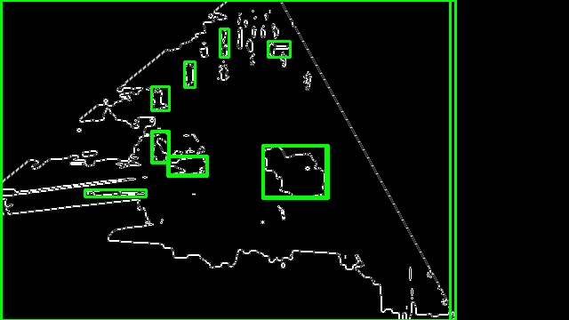
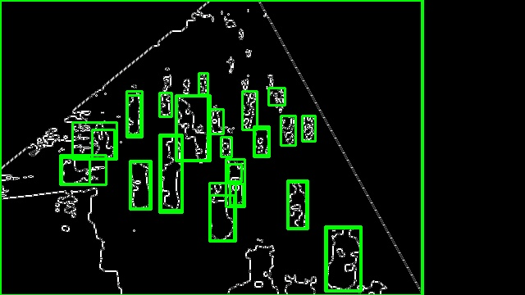
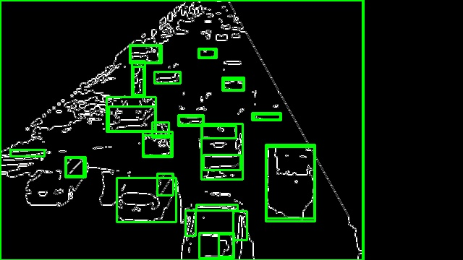
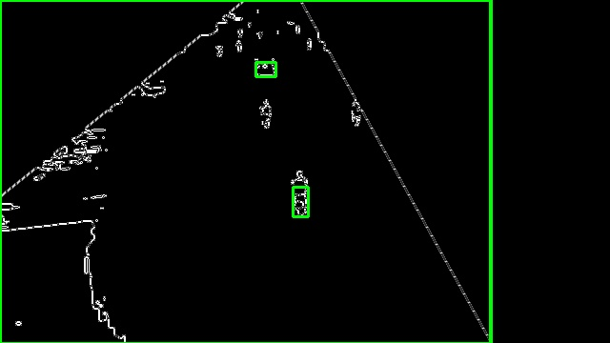
Blob Analysis Results
Note:
We have added a “tolerance” value to account for any unexpected imperfections that may occur when capturing our frame and to account for the number of vehicles we consider to be too much to stay held back in the Red Signal

Slide 18
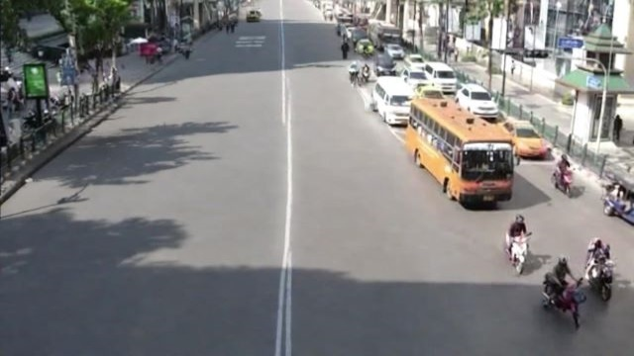
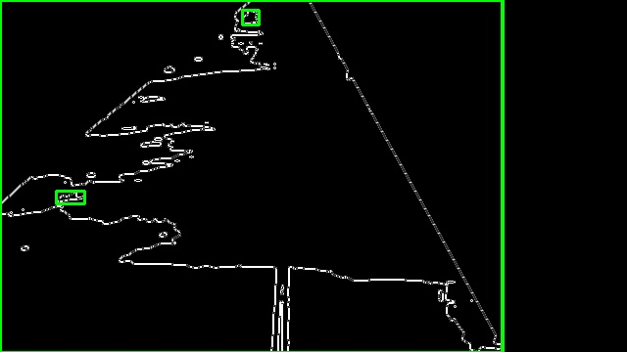
Output
Reference for Empty Road
Processed Image of Empty Road
Using this Image as the reference for a Empty Road
As Mentioned earlier we would need to add a threshold value separately to account for the number of vehicles we are allowed to hold back at the signal before the number becomes too much

Slide 19
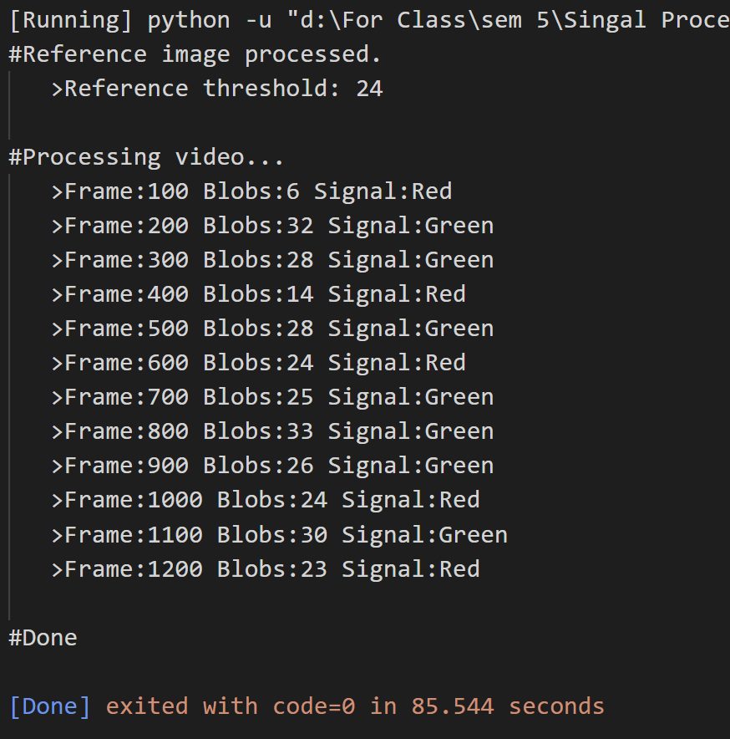
Output

Slide 20
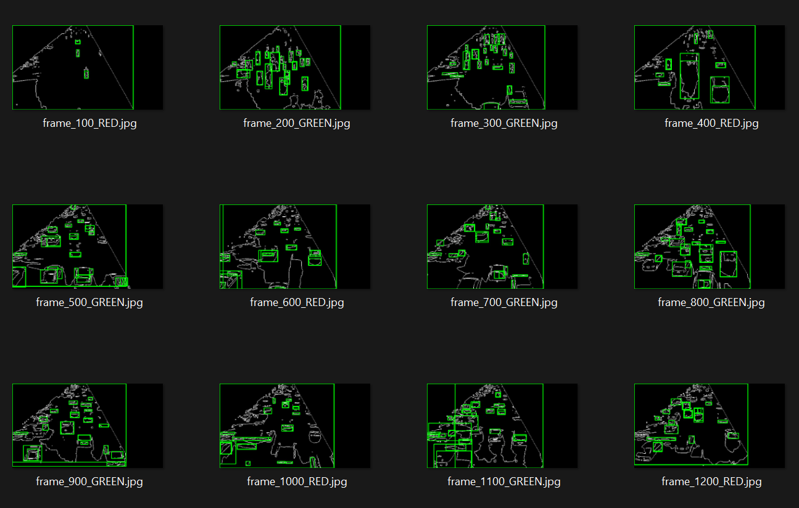
Output

